Slide 1

SwoleMates
Team I: Allison, Jeton, Zhonglin (Loya), Madi, Alim
Notes:
Address User Stories here

Slide 2
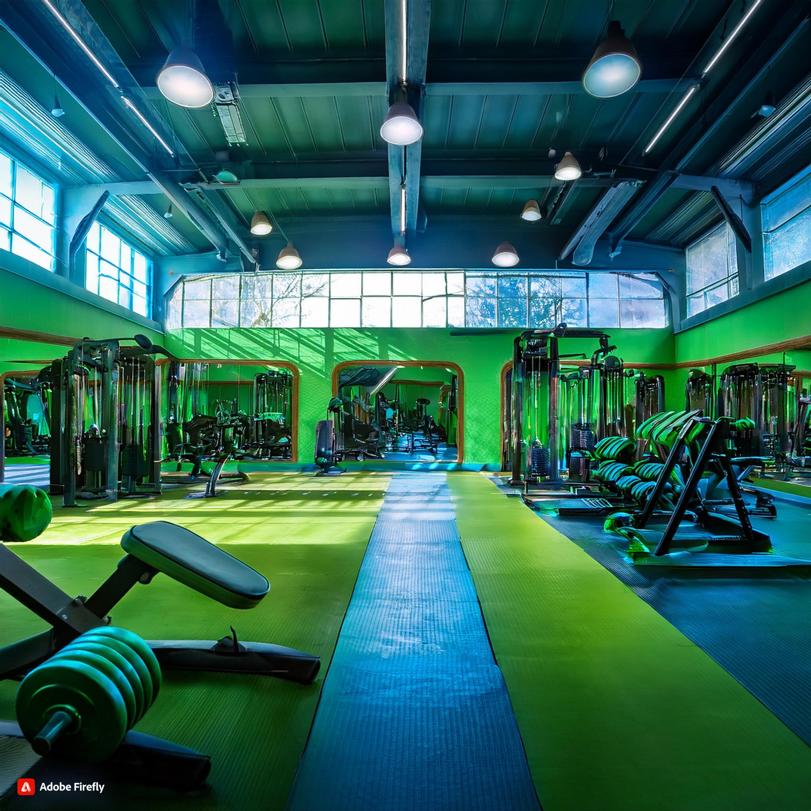
Notes:
Profs comments: Why not start by showing a big, complicated gym that a newbie can't possibly understand - you had the picture up there already - and then show how your app will help.

Slide 3
What is SwoleMate?
Addressing Fitness Challenges
Filtered Matching System
Enhanced Social Experience
Unique in Market
Notes:
Problem Statement / Vision Statement

Slide 4
Application Demo

Slide 5
Technology Stack
TypeScript
FIGMA
Tailwind CSS (NativeWind)
Axios
Prettier
Sequelize
Mermaid
Notes:
Problem Statement / Vision Statement

Slide 6
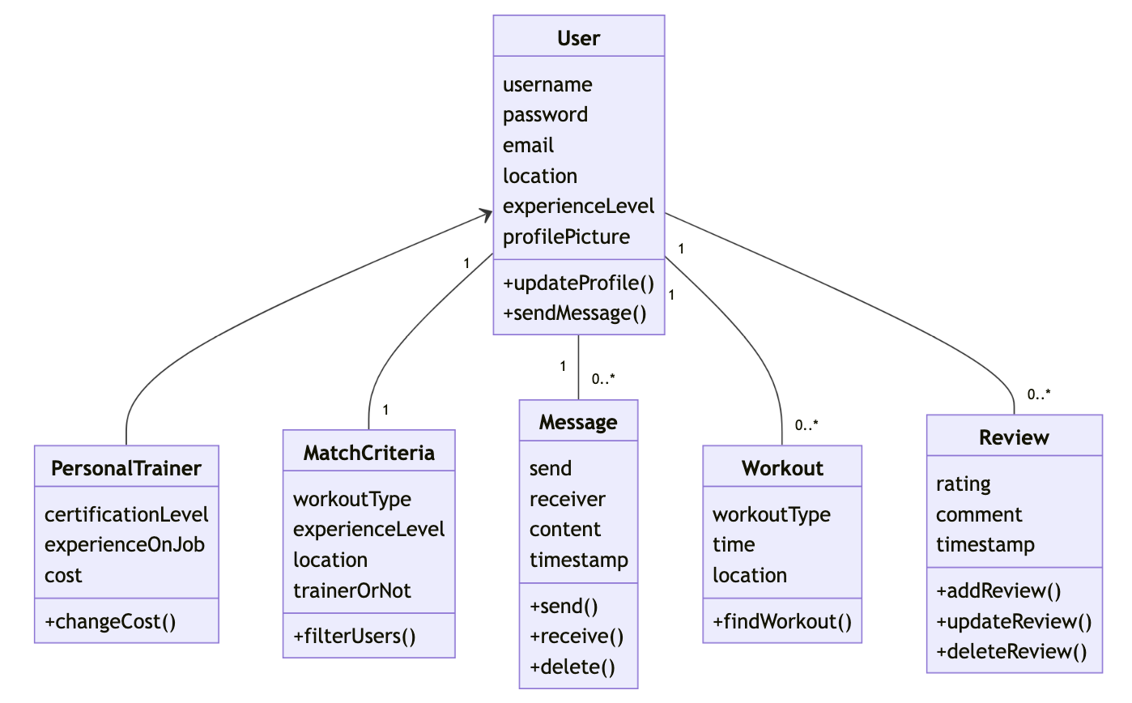
Domain Model

Slide 7
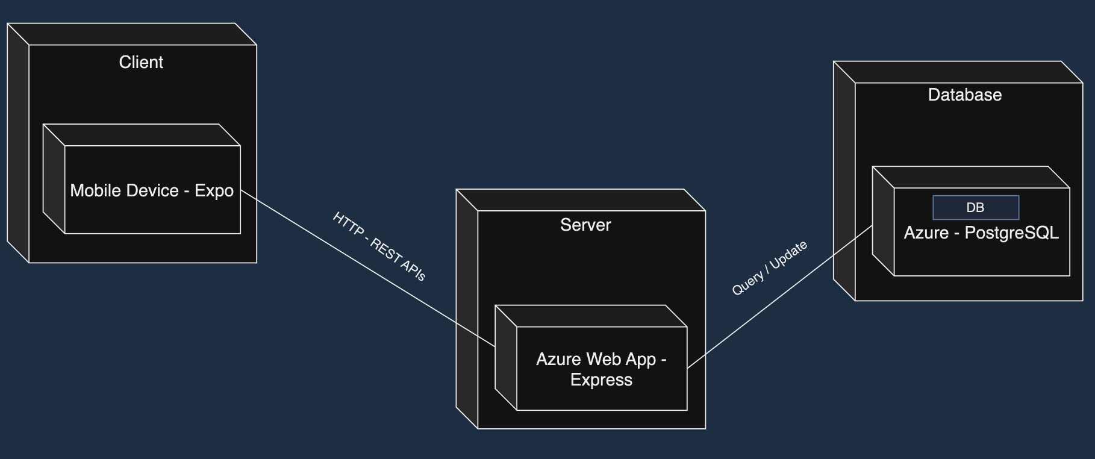
Deployment Diagram

Slide 8

Strengths of SwoleMates
Portable
Easy Navigation
Built-in Messenger
Find compatible gym buddies
Notes:
Problem Statement / Vision Statement

Slide 9
Weaknesses of SwoleMate
Privacy
Popularity
Server Security
Real Time Messaging
Notes:
Problem Statement / Vision Statement

Slide 10
Usability Test
Gender Filter
UI Enhancements
Notes:
Problem Statement / Vision Statement

Slide 11
Future Work
Upscale Server
Address Messaging
UI
Modularize
Additional Features
Notes:
Problem Statement / Vision Statement

Slide 12
Societal/Ethical Implications
Trade Off
Distribution
Idea
Ecological
Mythical
Notes:
Problem Statement / Vision Statement

Slide 13
Questions?

